Slide 1
Protection and Security in Operating System
System Protection: protection principles and domain, access matrix and its implementation, access controls and rights, capability-based system, language-based protection.

Slide 2
System Protection
Protection refers to strategy for controlling the access of program, processes, and users to resources.
It ensure that resources are used in consistent ways.
Further more, it ensure that each resource is accessed correctly and only by those process that are allowed to do so.

Slide 3
System Protection
If a computer program is run by an unauthorized user, then he/she may cause severe damage to computer or data stored in it.
So a computer system must be protected against unauthorized access, malicious access to system memory, viruses, worms etc.

Slide 4
Example of Protection
Privileged instructions – the process must be executing in kernel mode in order to execute without causing an exception.
Memory protection – the kernel address space is protected from user level instructions. Similarly one process’ address space is protected from access by another.
File system – one user’s files are protected from access by another user.

Slide 5
Goals of Protection
to prevent malicious misuse of the system by users or programs.
To ensure that each shared resource is used only in accordance with system policies.
To ensure that errant programs cause the minimal amount of damage possible.
System protection only provide the mechanisms for enforcing policies and ensuring reliable systems.
It is up to administrators and users to implement those mechanisms effectively.

Slide 6
Principles of Protection
Principle of least privilege :
dictates that programs, users, and systems be given just enough privileges to perform their tasks.
Ensure a little damage even if system fails
Example:
if a program needs special privileges to perform a task, it is better to make it a Set Group ID (SGID) program with group ownership of "network" or "backup" or some other pseudo group, rather than Set User ID(SUID) with root ownership

Slide 7
Domain of Protection
Computer System is consists of objects and process
Objects consists of both hardware objects (CPU, Memory)and software objects(files and programs)
Each domain defines a set of objects and the types of operations that may be invoked on each object.

Slide 8
Domain of Protection
An access right is the ability to execute an operation on an object.
A domain is defined as a set of
< object, { access right set } > pairs
Example if domain D has the access right <file F,
{read, write}> then a process executing on domain D can both read and write file F. However, it can’t perform other operation on it.

Slide 9
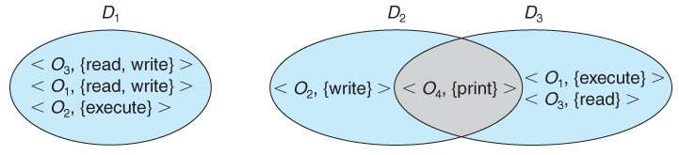
Domain of Protection
Domain can overlap: Permission in overlap are available to both domains.

Slide 10
Protection Domain
A domain can be realized in various way:
Each user may have a domain. In this case the set of object that can be accessed depends upon the identity of user.
Each process may have a domain. In this case the set of object that can be accessed depends upon the identity of process.

Slide 11
Crossing Domain
We want users to have controlled access to resources they don’t have direct access to.
e.g. a database, particular hardware, networks
So we give the user access to a program that does have access to the restricted resource.
Crossing domains is dangerous and is commonly used to attack systems.

Slide 12
An Example: UNIX
UNIX associates domains with users.
Here users ID is used to identify the domains

Slide 13
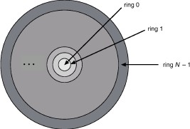
Multics ring structure: Domain Protection
Let Di and Dj be any two domain rings.
If j < i ⇒ Di ⊆ Dj Then a process executing in Dj has more privileges than one executing in Di.

Slide 14
Access Matrix
A model of system protection called access matrix,
Where columns represent different system resources and rows represent different protection domains.
Entries within the matrix indicate what access that domain has to that resource.

Slide 15
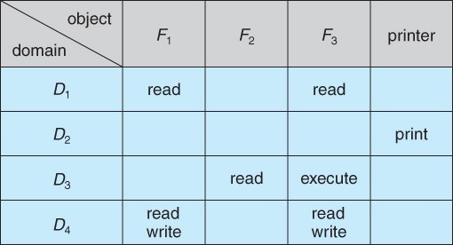
Example

Slide 16
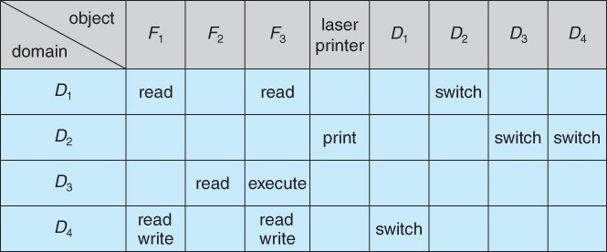
Domain Switching

Slide 17
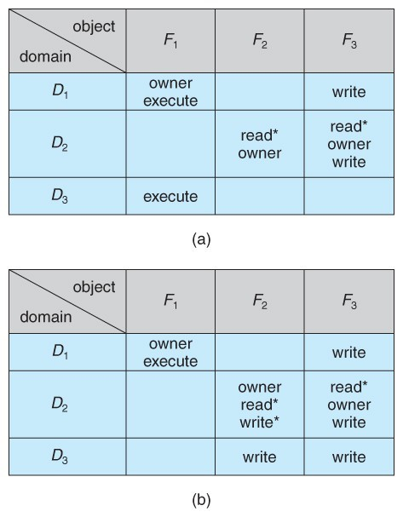
Access Matrix : Owner Right
The owner right adds the privilege of adding new rights or removing existing ones:

Slide 18
Implementation of Access Matrix
It Contains a set of ordered triples
<domain,object,rights-set>
Whenever an operation M is executed on an object Oj within domain Di the global table is searched for a triple <Di,Oj,R_{k} > where M Є R_{k}
If this triple is found, the operation is allowed to continue or else an exception is raised.

Slide 19
Implementation of Access Matrix
Global Table
The simplest approach is one big global table with
< domain, object, rights > entries.
Unfortunately this table is very large ( even if sparse ) and so cannot be kept in memory ( without invoking virtual memory techniques. )
There is also no good way to specify groupings - If everyone has access to some resource, then it still needs a separate entry for every domain.

Slide 20
Implementation of Access Matrix
Access Lists for Objects
Each column implemented as an access list for one object
Resulting per-object list consists of ordered pairs < domain, rights-set > defining all domains with non-empty set of access rights for the object
Easily extended to contain default set -> If M ∈ default set, also allow access.

Slide 21
Access List (cont…)
Each column = Access-control list for one object .
Defines who can perform what operation
Domain 1 = Read, Write Domain 2 = Read Domain 3 = Read

Slide 22
Implementation of Access Matrix
Capability Lists for Domains
Instead of object-based, list is domain based
Capability list for domain is list of objects together with operations allows on them
Object represented by its name or address, called a capability
Execute operation M on object O_{j}, process requests operation and specifies capability as parameter
Possession of capability means access is allowed
Capability list associated with domain but never directly
accessible by domain
Rather, protected object, maintained by OS and accessed indirectly
Like a “secure pointer”
Idea can be extended up to applications

Slide 23
Capability List(cont..)
Each Row = Capability List (like a key)
For each domain, what operations allowed on what objects
Object F1 – Read
Object F4 – Read, Write, Execute Object F5 – Read, Write, Delete, Copy

Slide 24
Implementation of Access Matrix
A Lock-Key Mechanism
Each resource has a list of unique bit patterns, termed locks.
Each domain has its own list of unique bit patterns, termed keys.
Access is granted if one of the domain's keys fits one of the resource's locks.
Again, a process is not allowed to modify its own keys.

Slide 25
Comparison of Implementations
Many trade-offs to consider
Global table is simple, but can be large
Access lists correspond to needs of users
Determining set of access rights for domain non-localized difficult
Every access to an object must be checked
– Many objects and access rights -> slow
Capability lists useful for localizing information for a given process
But revocation capabilities can be inefficient
Lock-key effective and flexible, keys can be passed freely from domain to domain, easy revocation

Slide 26
Access Matrix Implementation
Each method has advantage and disadvantages
Many commercial system uses combination of these system

Slide 27
Access Controls
Role-Based Access Control, RBAC assigns privileges to users, programs, or roles as appropriate, where "privileges" refer to the right to call certain system calls, or to use certain parameters with those calls.
RBAC supports the principle of least privilege, and reduces the susceptibility to abuse as opposed to SUID or SGID programs

Slide 28
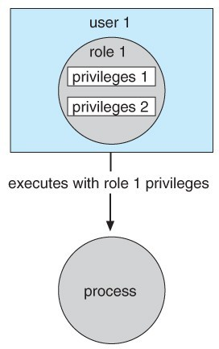
Role-Based Access Control
Role based access control in solaris 10

Slide 29
Thank You

